Slide 1
Computer Sales Point
A Project of Shpaater Group

Slide 2
Title and Content Layout with List
Menu Function
Addition of record to Store Function
Updation of record stored in stock Function
Deletion of ANY record stored in stock Function
Sales Info Collection (about customer and product) Function
Sales Invoice Function (Whole Sale’s Report & Single customer’s Sale’s invoice)

Slide 3
Libraries
#include<iostream> Input output
#include<iomanip> Set width
#include<fstream> File input & output
#include<sstream> insertion, extraction
#include<cctype> toupper, tolower function etc.

Slide 4
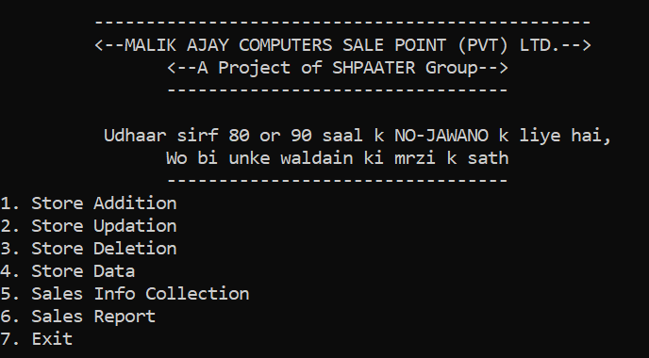
Prototypes
void Menu();
void storeAddition(int*);
void storeUpdation(int);
void storeDeletion(int*);
void storeData(int);
void salesInfo(int*, int);
void salesReport(int);

Slide 5
Simple outline of code
Main Func
Store Funcs
Import store’s data from a file
Import sales’ data from file
Addition of data in store
Store Data Updating
Perform action according to user’s choice
“Funcs” are called in IF statements
Store Data Deleting
Sales Funcs
Customer’s Info Collection
Product’s Data Collection for sale
Display Functions
Menu
Store Data
Sale’s Invoice Report
Structures
Store
Sales

Slide 6
Main Function
Firstly, Data for store is imported from a file(“store.txt”).
Then Data of All the sale made(if any) is imported from file(“sales.txt”).
After it, all the functions are called inside it according to user’s choice controlled by if conditions.
Program terminates when the user’s choice is 7.

Slide 7
Store Functions
Store Addition
Store Data Updating & Deleting
Company
Model
Generation
System type (bit)
RAM & Hard
Price
& Quantity to add in store
are inputted by user
Whole Data in store is displayed calling storeData(int) func.
Sr-no which user wants to update is asked from user (also while deleting).
Any of these can be updated by the choice of user.
While Deleting, the records from the current sr# are overwritten by the next one till the last.

Slide 8
Sales Info
Customer Name
CNIC
Phone No.
Customer’s Address
Company Name (to buy a laptop from)
Are asked from customer, then it displays a table of data of store of specific company selected by the customer.
If no data is found then it prompts a message(“no laptop available of this company”). And then ask for another company for laptop.

Slide 9
User enters the Sr-No of product He / She wants to buy
All the specifications of the product are load from the members of struct Store to the members of struct Sales
RAM & SSD are extendible (if customer wants)
The price of Extended RAM and SSD are added to the original price of laptop
It outputs the record to file named “sales.txt”
Then ask customer for further shopping

Slide 10
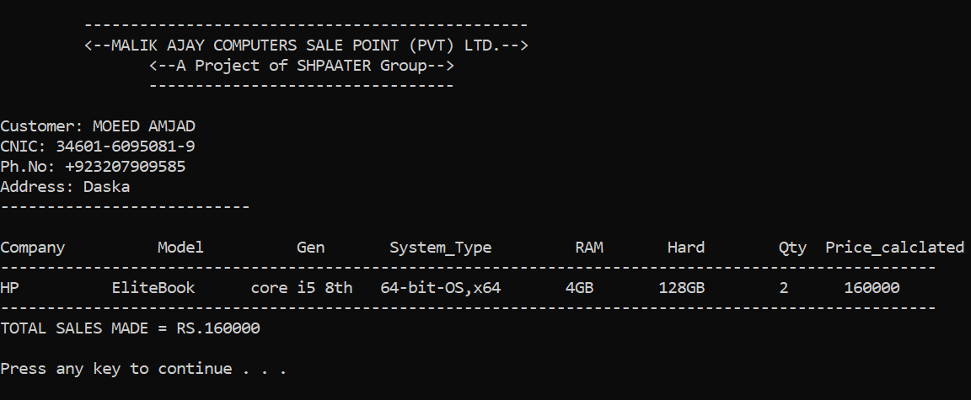
Sales invoice
Single order report
All the sale’s data of one customer

Slide 11
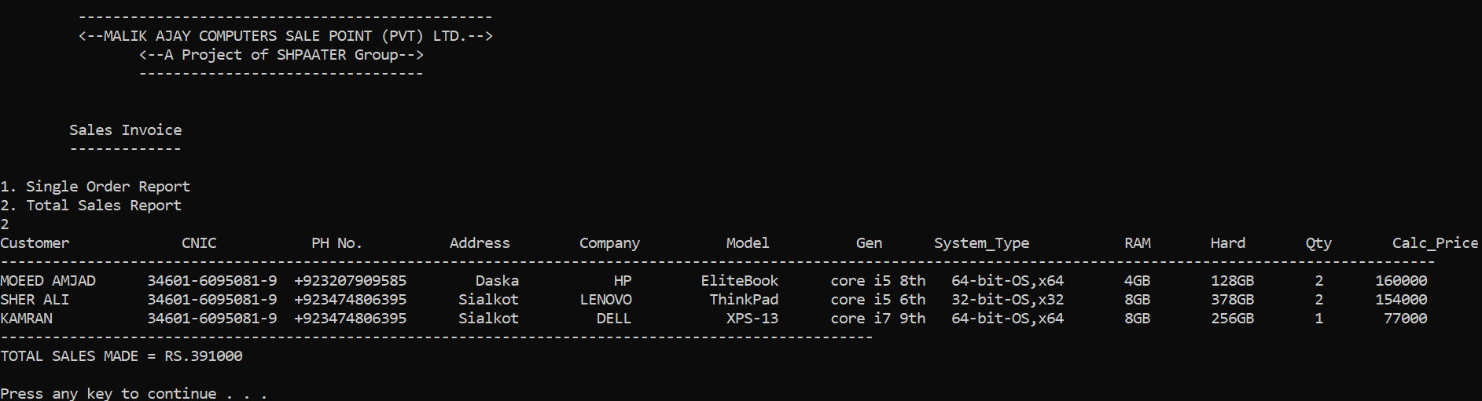
SALES REPORT
Total sales report
Record of all the sale made for ALL the orders
Multiple order sale’s report

